Slide 1
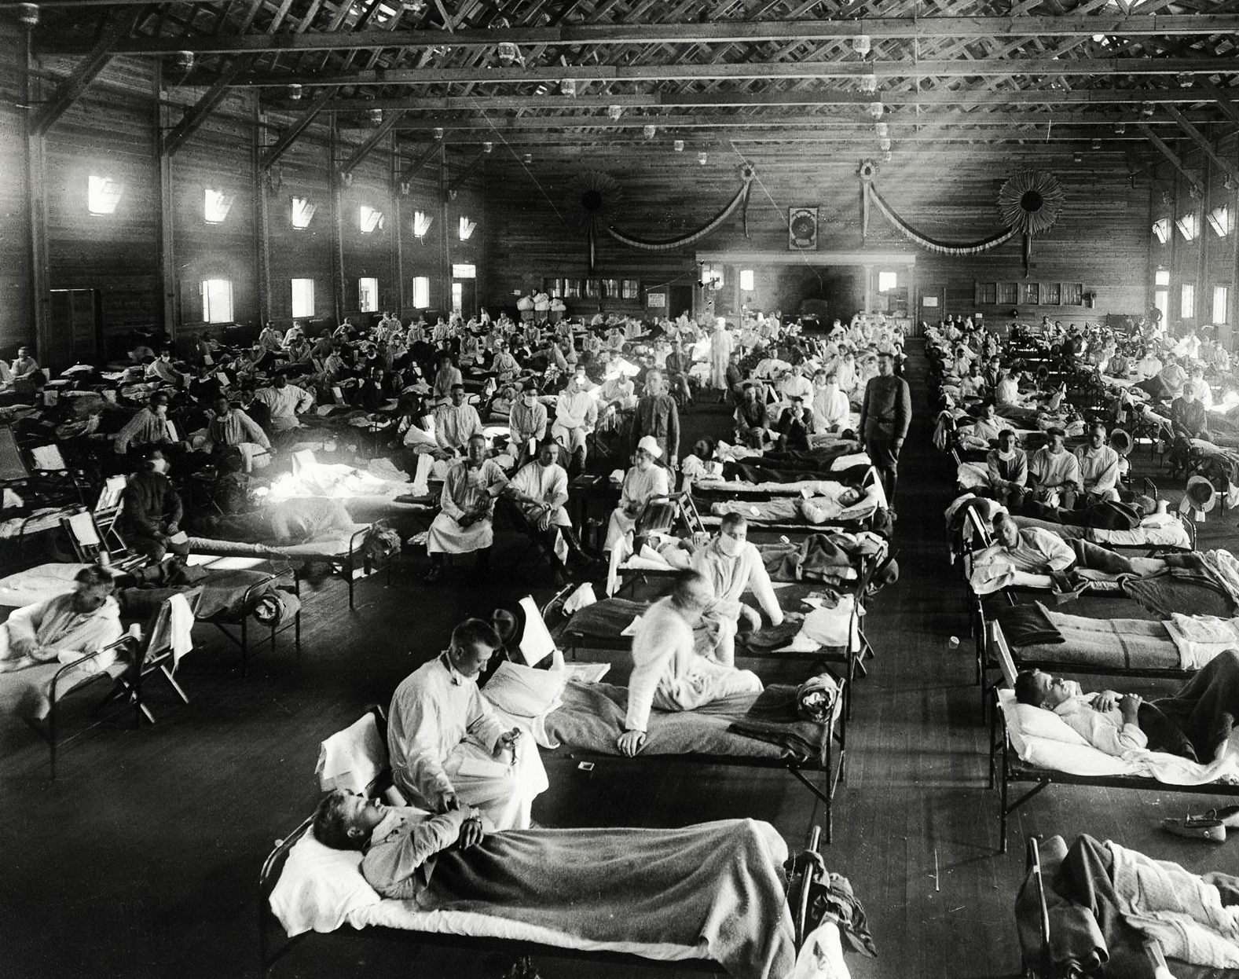
Spatial and Temporal Analysis of Influenza Virus Occurrence
The Wrangling Sixers
National Museum of Health and Medicine, 1918

Slide 2
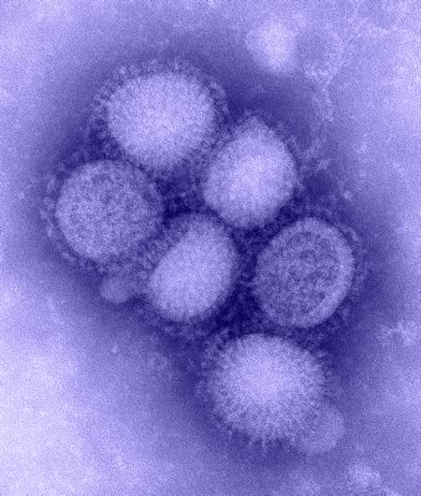
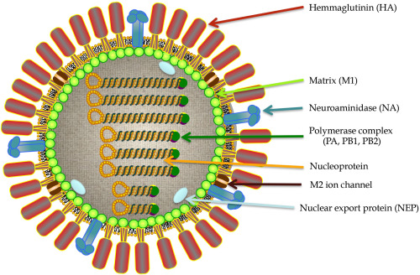
Influenza Virus Background
Glycoproteins recognized by our immune system:
Hemmaglutinin – 18 H subtypes
Neuroaminidase – 11 N subtypes
2 species of influenza in our dataset:
A: H and N subtypes; Seasonal and pandemic
B: Yamagata and Victoria lineages; Seasonal
https://www.cdc.gov/h1n1flu/images.htm
The Microbiology of Respiratory System Infections

Slide 3
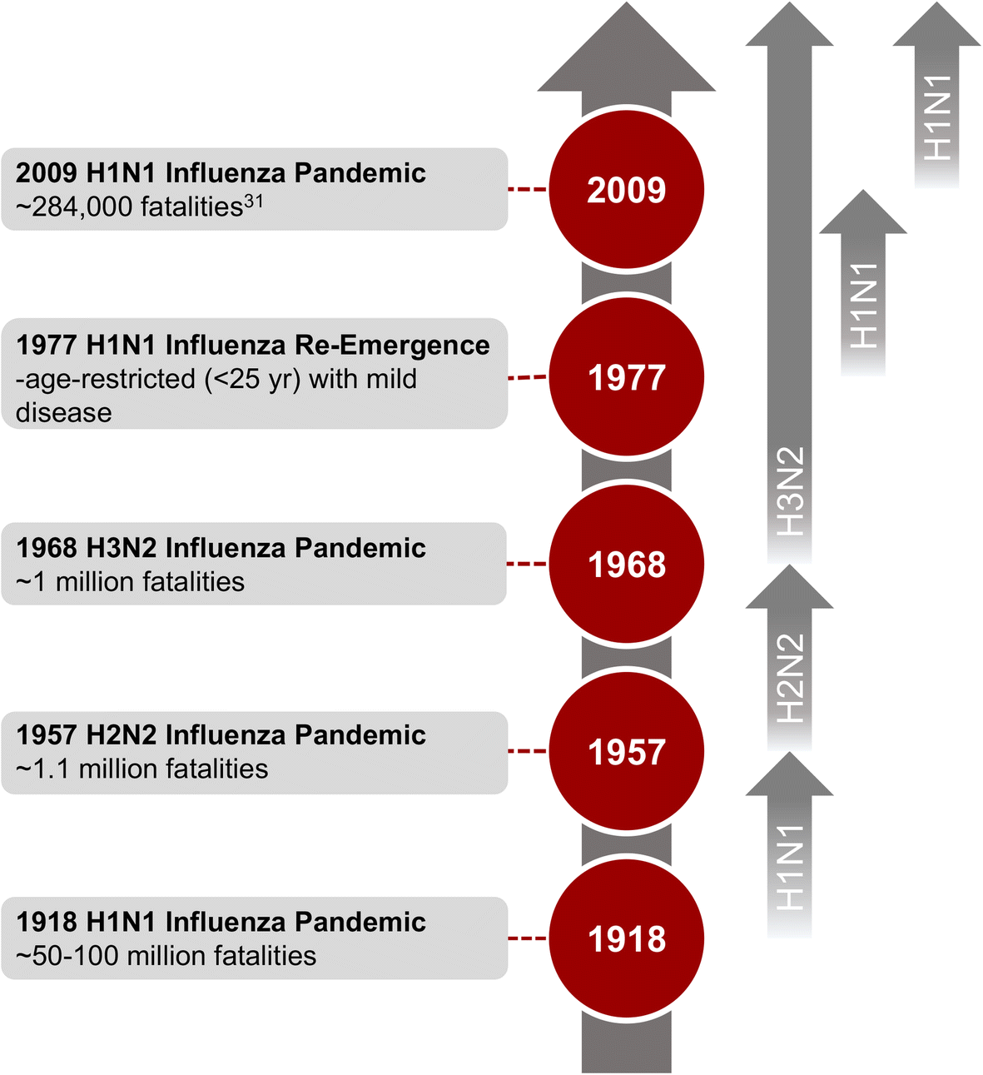
Flu Pandemics During the Last Century
300 – 600k deaths each year from seasonal flu
BMC Infectious Diseases volume 19, Article number: 117 (2019)

Slide 4

The Dataset
Global Initiative on Sharing All Influenza Data (GISAID) dataset
Current and retrospective sequence data
Geographic and temporal data
Subtype and lineage information
Additional information such as submitting lab, host information, etc...
Curate the dataset to allow for better understanding of influenza occurrence
Compare recent pandemic of 2009; inter-pandemic years, and during Covid-19 pandemic.

Slide 5
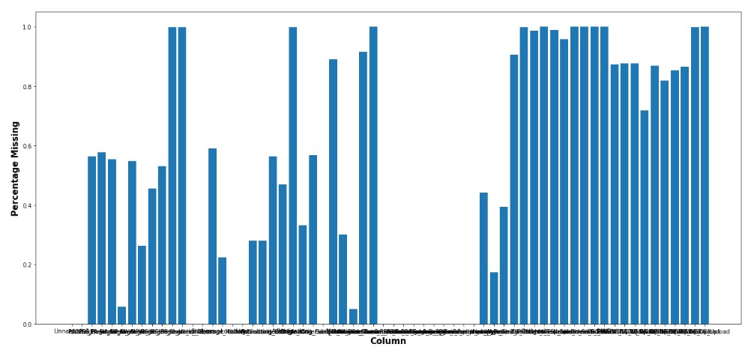
Data Quality Before Cleaning
Biggest issue with data quality of the original dataset was missing values
Format of geographic and date information also made the original dataset difficult to use for the proposed analysis

Slide 6
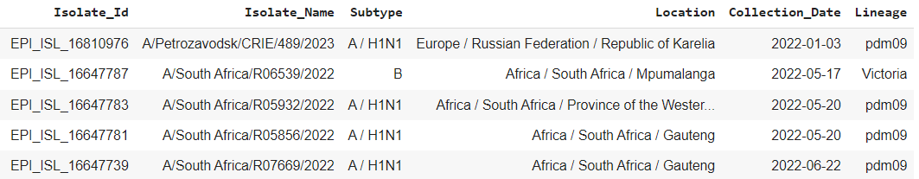
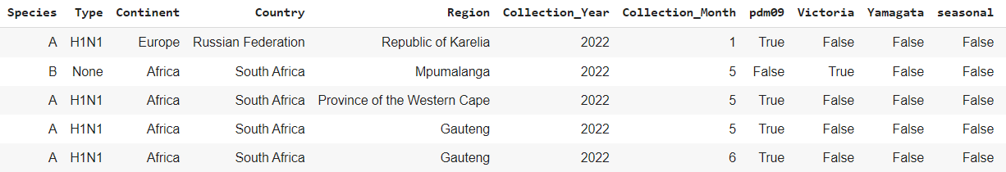
Data Cleaning
Six columns selected from the 64 columns in the raw data
Influenza C isolates filtered out
Composite data columns parsed into separate columns

Slide 7
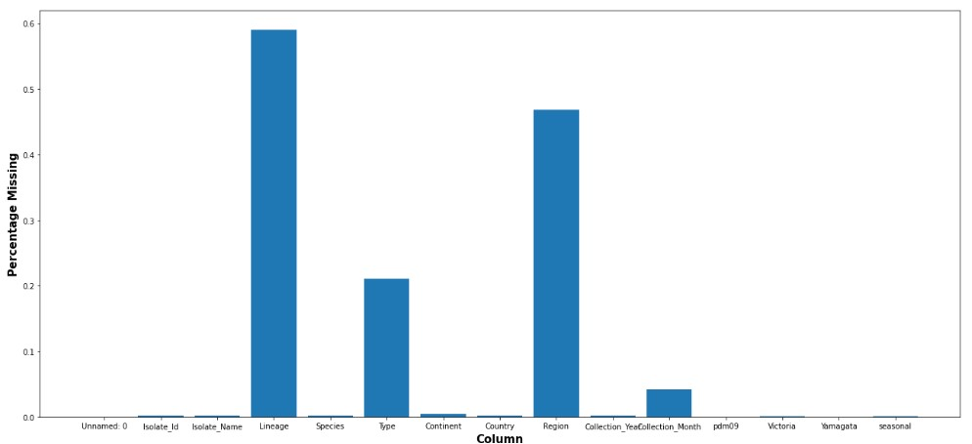
Data Quality After Cleaning
Biggest change to data quality was reducing the amount of missing data
Date and Geographic location information was separated out into individual columns to make data more suitable for proposed analysis

Slide 8

Exploratory Data Analysis (EDA)
Explore the data
Further DQ validation
Preliminary analyses

Slide 9
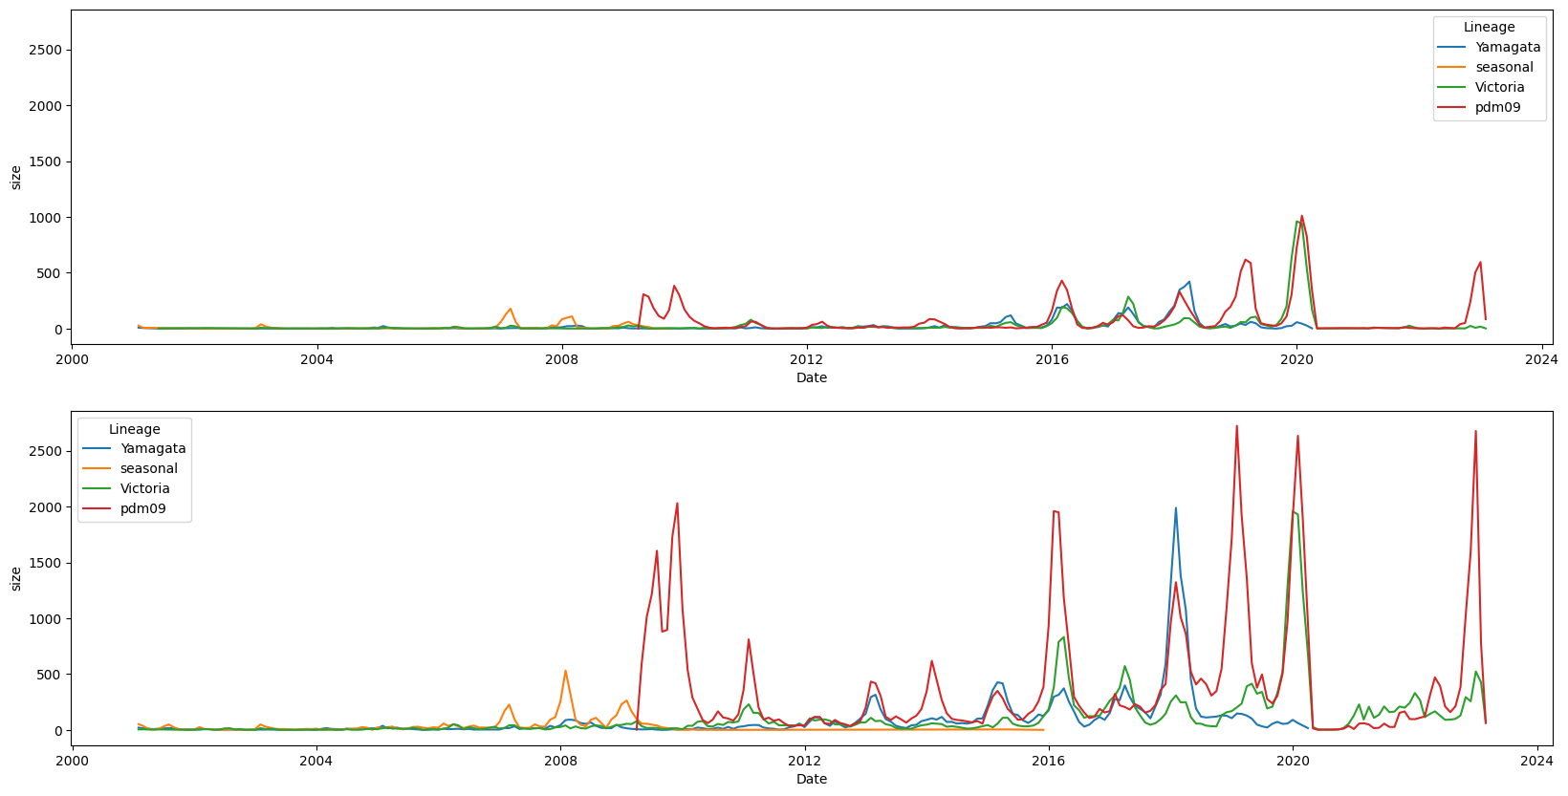
Lineage Counts across time
United States Counts
Global Counts

Slide 10
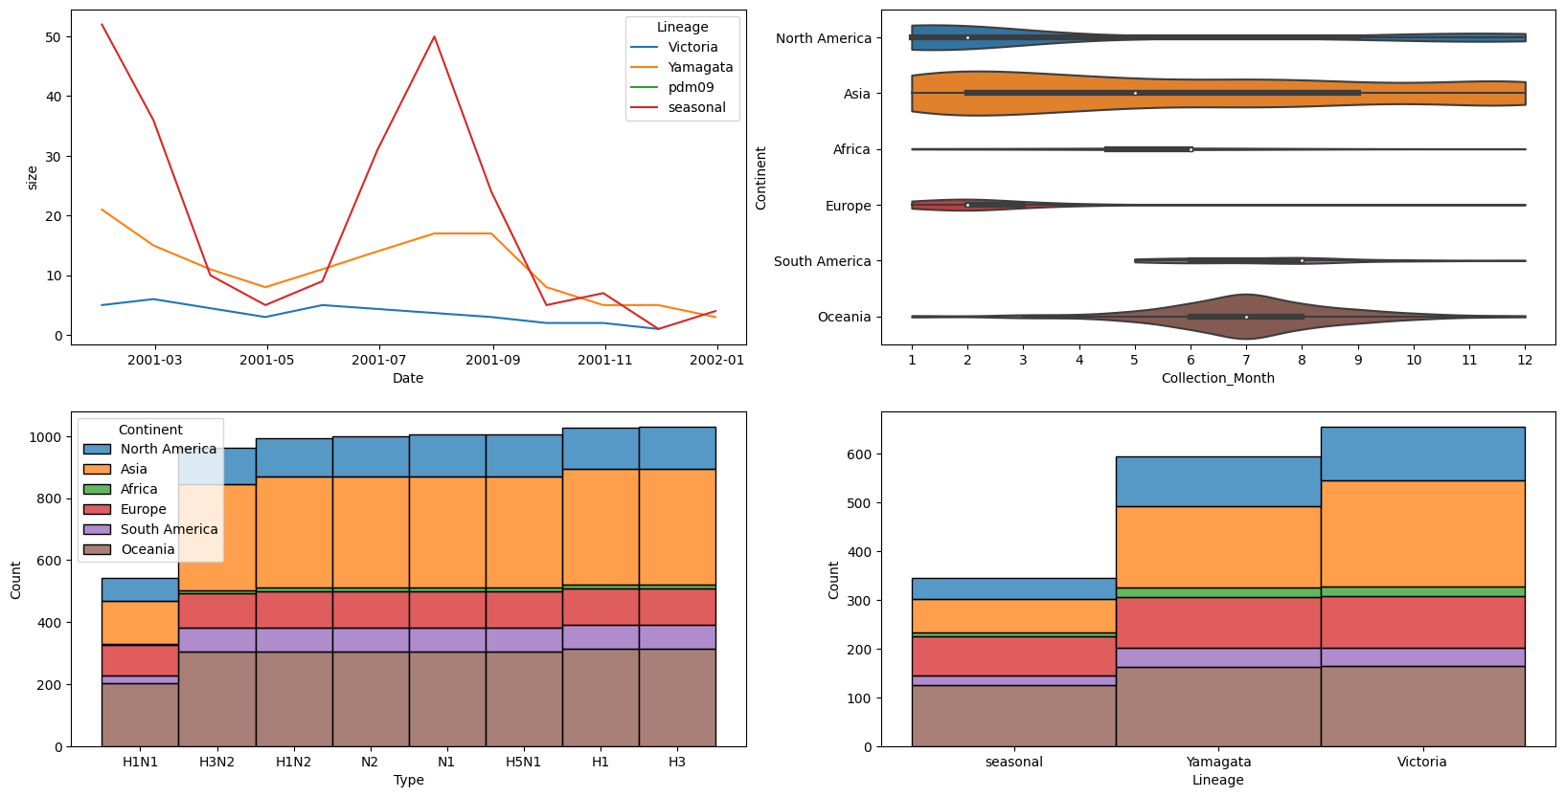
Interactive Plots

Slide 11
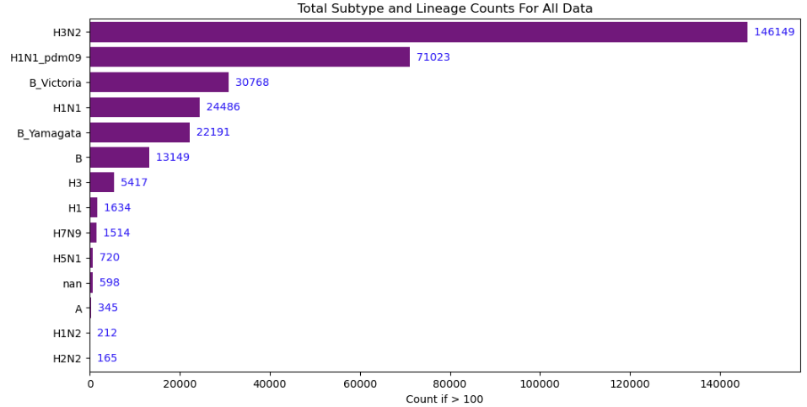
Most Common Subtypes in the Dataset
Subtypes that occur less than 100 times:
H7N1, H4, H3N1, H6N1, H11, H5N8, N4, H13N6, H10N7, H3N3, H7N4, H7N3, H7N2, H10N8, H3N8, H10N3, N1, H5N6, H7N7, N2, H9N2

Slide 12
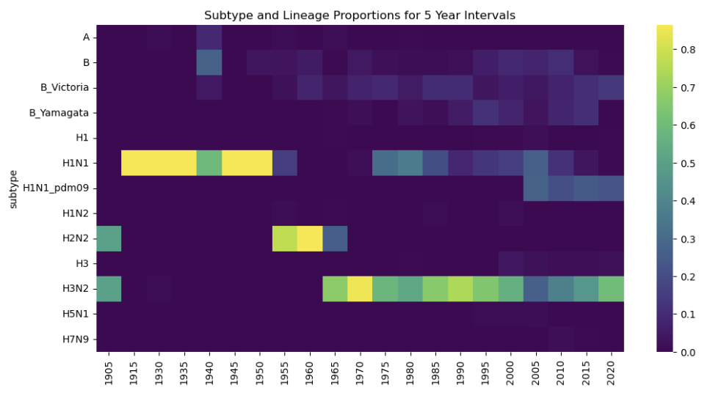
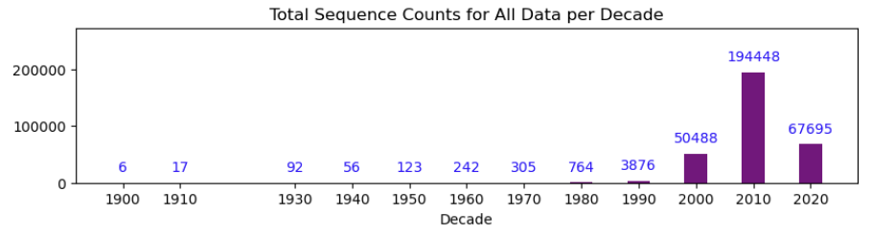
Subtype Proportions Over Time
Subtypes with > 100 isolates are shown in the heatmap
Isolates sequenced from samples collected prior to 2000s are uncommon and may not represent realistic proportions
The major pandemics are identifiable in the dataset

Slide 13
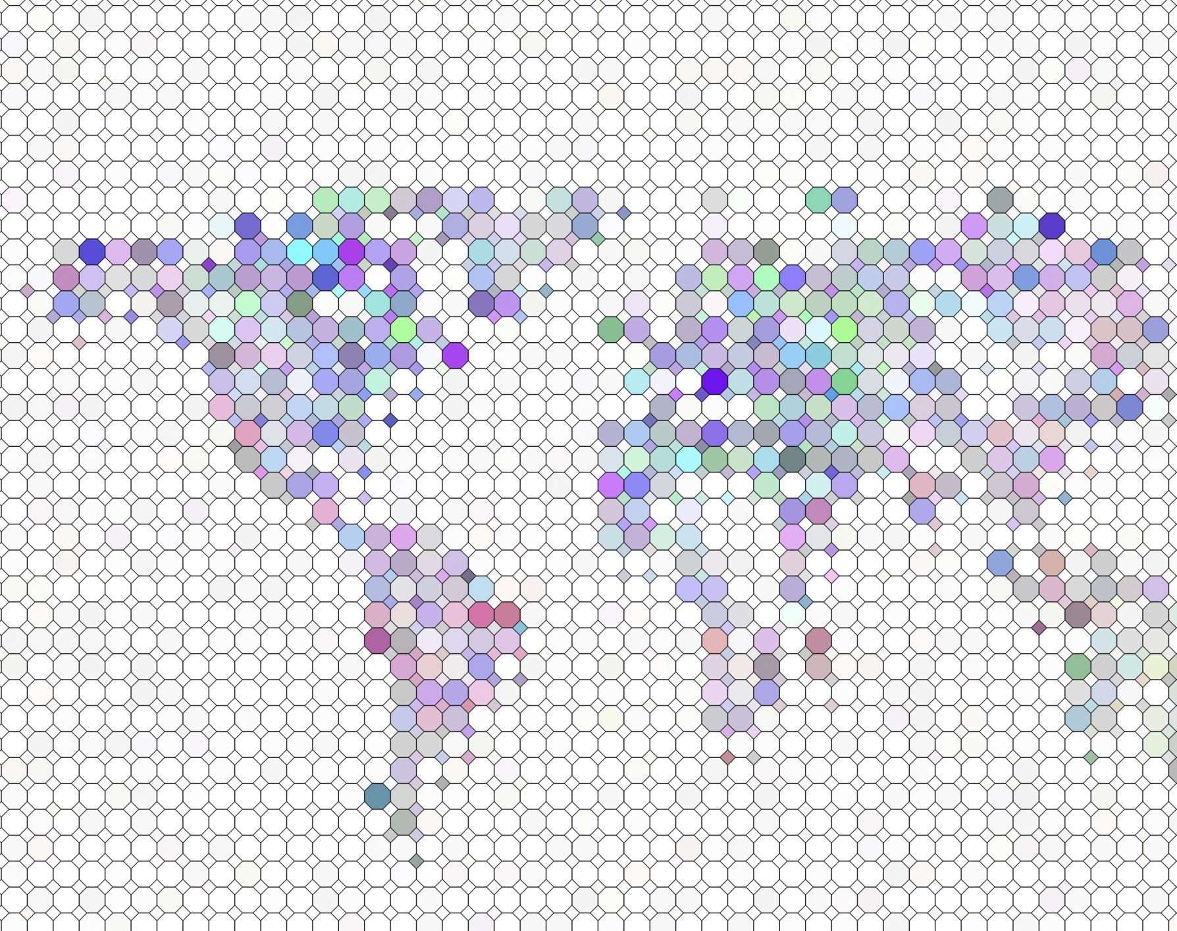
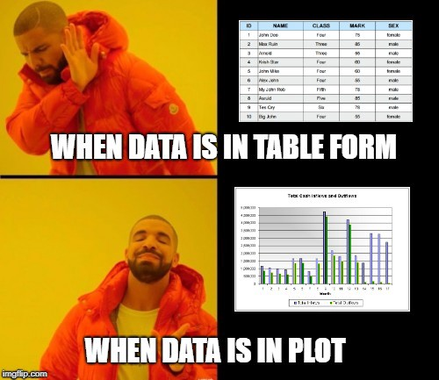
Data Visualization
Interactive map (Folium)
Choropleth (geopandas)

Slide 14
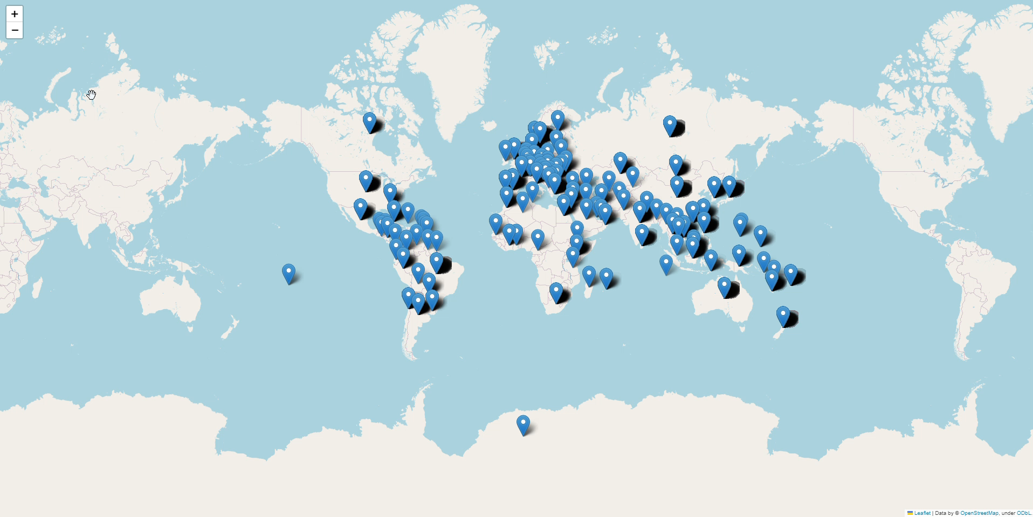

Slide 15
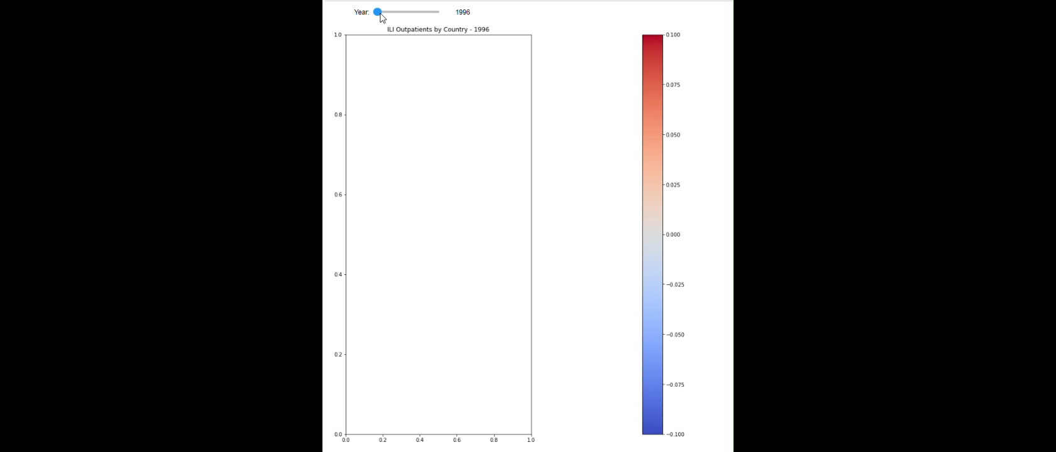

Slide 16
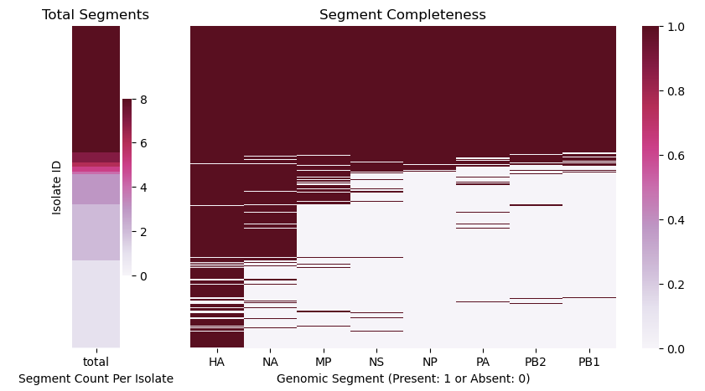
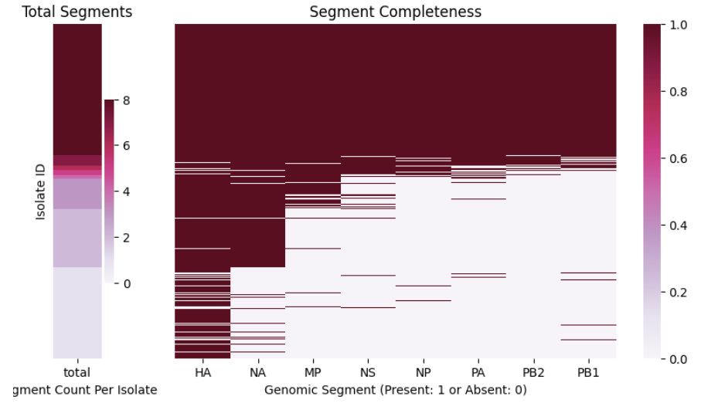
Genomic Sequence Data Completeness
present
absent
Genomic data is linked to the descriptive data by isolate IDs and segment IDs

Slide 17
Fit-for-Use Discussion
Potential Use for Dataset
Dataset Limitations
Qualitative assessment as shown previously
Evolutionary trends in time and space with sequence data for the RNA genomic segments
Identify specific mutations and link to the descriptive data
Study sequence relationships back to the early 1900s
Identify major epidemiological trends can be identified as it relates to sequence divergence
Incomplete genomes for many isolates
Bias in geographical location towards westernized countries
Limited sequence data prior to the 2000s
Limited use for epidemiological studies involving population infection rates over space and time
Population infection estimates are bias towards certain countries and later years and would require additional data to be linked to this dataset
Rare subtypes (e.g., H5N1) may not have a large enough sample size for robust analysis

Slide 18

Thank you!

